Slide 1

Q&A PLATFORM FOR EDUCATORS
Supervisor: Mr. Nguyen Huy Hung
Team members: Kha Hoang Minh (Leader) Truong Nhu Khang

Slide 2
Out line
1. Introduction
2. Scope
3. Demonstration
4. Future plan
5. Q & A

Slide 3
INTRODUCTION

Slide 4

What is Q&A Platform for educators?
Q&A Platform for Educators (QAPE) is an online website where users can exchange information and other educational articles or materials

Slide 5


Who are users of Q&A Platform for Educators?
Teacher
Teacher
Lecturer
Professionals
Experienced person
Student
Student
Beginner
Person who wants to broaden his knowledge

Slide 6


Why is Q&A Platform for educators?
Problem
Some students feel shy when asking at school
Lack of school time
It’s difficult to get more ideas from experienced people or professionals

Slide 7
Why is Q&A Platform for educators?
Problem
Almost existed Q&A websites do not support true teaching and studying environment
They do not focus on education or only focus on one major of education

Slide 8


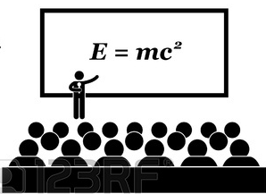



HOW does Q&A PLATFORM for educators work?
owns
Teacher A’s classroom
is invited to
Teacher A
Student A
requests to join
belongs to
is invited to answer
Question
Teacher B
Student B

Slide 9
SCOPE

Slide 10



System
Suggests questions, articles, materials for teachers and students via news feed
Supports real time discussion and real time notification
Suggests mergeable questions to teacher

Slide 11
General features
Posts and manages questions or articles
Answers a question or reply an article
Accepts an answer
Requires answers for question
Follows teachers

Slide 12
Teacher
Creates and manage classrooms
Uploads materials
Invites students to join a classroom
Invites teachers to answer an question
Merges questions
Track students’ question

Slide 13
Student
Requests to join a classroom
Creates folder to store material online

Slide 14
DEMONSTRATION

Slide 15





NEWS feed
View
Display
Student
View
System
News feed screen
Update list of question every hour
Load list of questions
Teacher

Slide 16
NEWS feed: Algorithm
Problems: How to display suitable questions for each individual user?
Solution: Evaluate question’s score base on the importance of a question.

Slide 17
NEWS FEED: Algorithm
Step 1: Separate questions into 3 groups
Questions belong to joined classrooms or owned classrooms
More important
Questions belong to followed teachers
Questions belong to user’s specialty
Less important

Slide 18
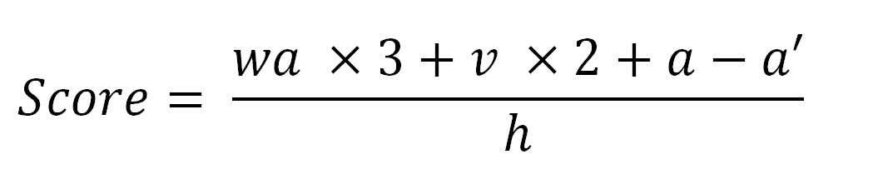
NEWS FEED: Algorithm
Step 2: Calculate question’s score
For each question in a group, question’s score is calculated based on:

Slide 19
NEWS FEED: ALGORITHM
Step 3: Order questions by questions’ score (descending)

Slide 20
NEWS FEED: ALGORITHM
ARTICLES & MATERIAL
Articles/Materials belong to followed teachers (order by date)
More important
Articles/Materials belong to user’s tags (order by date)
Articles/ Materials belong to user’s specialty (order by date)
Less important

Slide 21


Create classroom and invite student
Create
Teacher A
Send
Classroom: C++ Programming Language
Send
Notify
Invitation (to join classroom)
Student A

Slide 22

Join classroom and request to join
Send
Student A
Request to join classroom: Java programming language
Accept
Notify
Accept
Invitation (to join C++ programming language classroom)
Teacher A

Slide 23

create question
Create
Student A
Question (in Teacher A’s Java classroom)
Notify
Teacher A

Slide 24


ANSWER (REAL TIME), Accept AN ANSWER & REQURIE answers
Notify
Leave
Accept
Teacher A
An Answer (for Student A’s question)
Student A
Require answers

Slide 25
invite another teacher
Send
Notify
Invitation (to answer Nguyen A’s question)
Teacher A
Teacher B
Notify
Leave
Accept
Student A
An Answer (for Nguyen A’s question)

Slide 26

Upload material – Add material to folder
Upload
Add to folder
Material (in Teacher A’s classroom)
Teacher A
Student A

Slide 27


Merge questions – answer Multi questions
Select questions
Merge
Teacher A
List of question
Merging
Leave
Leave
Notify
List of students
Answers/Merged note (for list of questions)

Slide 28
Merge questions: ALGORITHM
Problems:
Given set A of question title
{What is abstraction in OOP,
How to convert String to Int,
What is inheritance in OOP,
How to parse String to Int}
Result:
{What is inheritance in OOP,
What is abstraction in OOP,
How to convert String to Int,
How to parse String to Int}
Notes:
Thuat toan sap xep cac tieu de cau hoi dua tren su giong nhau ve mat noi dung, nhung tieu de cau hoi co noi dung tuong tu nhau se duoc sap xep gan nhan .

Slide 29
Merge questions: ALGORITHM
Step 1: Calculate total similar score of each element in set.
Calculate similar score of 2 strings.
What is abstraction in OOP
S1={wh,ha,at,ti,is,sa,ab,bs,st,tr,ra,ac,ct,ti,io,on,ni,in,
no,oo,op}
What is inheritance in OOP
S2={wh,ha,at,ti,is,si,in,nh,he,er,ri,it,ta,an,nc,ce,ei,no ,oo,op}
Notes:
Similar score: điểm đánh giá sự giống nhau
Tinh tong so diem giong nhau cua moi phan tu trong tap hop
Diem giong nhau la bieu hien cho su giong nhau ve mat noi dung cua 2 chuoi, diem giong nhau cang cao thi 2 chuoi co noi dung can giong nhau .
Dau tien chung se chia chuoi thu nhat thanh mot tap hop cac phan tu goi la S1 , moi phan tu bao gom 2 ki tu duoc chia ra tu chuoi mot cach tuan tu

Slide 30
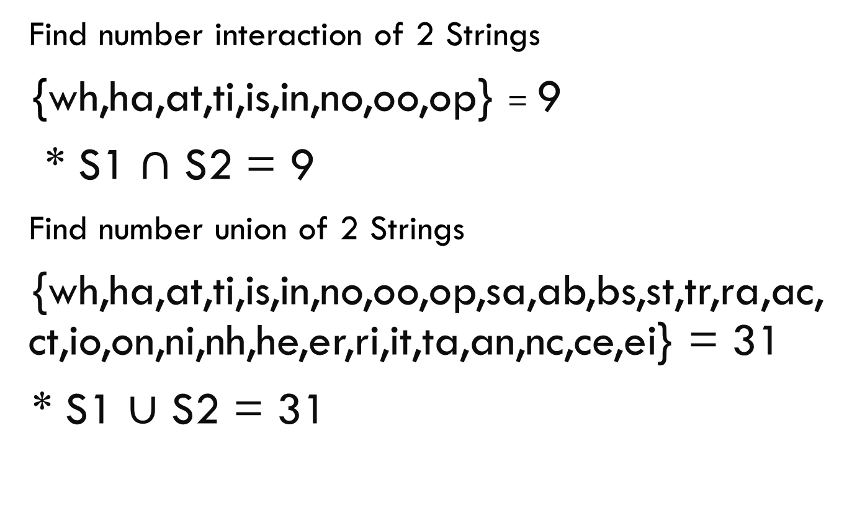
Merge questions: ALGORITHM
Find number interaction of 2 Strings
{wh,ha,at,ti,is,in,no,oo,op} = 9
* S1 $∩$ S2 = 9
Find number union of 2 Strings
{wh,ha,at,ti,is,in,no,oo,op,sa,ab,bs,st,tr,ra,ac,ct,io,on,ni,nh,he,er,ri,it,ta,an,nc,ce,ei} = 31
* S1 $∪$ S2 = 31
Notes:
Tim so phan tu giao giua 2 tap hop , o day chung ta co 9 phan tu
Tim so phan hoi giua 2 tap hop , o day chung ta 31 phan tu

Slide 31
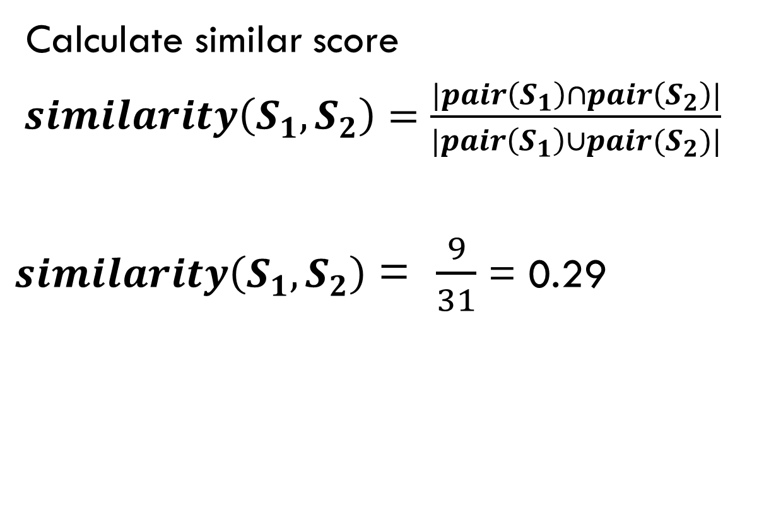
Merge questions: ALGORITHM
Calculate similar score
$similarity\left(S_{1},S_{2}\right)=\frac{|pair\left(S_{1}\right)∩pair\left(S_{2}\right)|}{|pair\left(S_{1}\right)∪pair(S_{2})|}$
$similarity\left(S_{1},S_{2}\right)$ = $\frac{9}{31}$ = 0.29
Notes:
Ti le giua so phan tu giao va so phan tu hoi cua 2 tap hop

Slide 32
Merge questions: ALGORITHM
Calculate total similar score of each element in set.
A = {What is abstraction in OOP,
How to convert String to Int,
What is inheritance in OOP,
How to parse String to Int}
A1 = What is abstraction in OOP
A2 = How to convert String to Int
A3 = What is inheritance in OOP
A4 = How to parse String to Int
Notes:
Sau khi co cong thuc tinh do giong nhau giua 2 chuoi . Chung ta se bat dau tinh tong do giong nhau cua tung phan tu trong tap hop

Slide 33
Merge questions: ALGORITHM
Calculate total score of A1 .
TotalA1 = similarity(A1,A2) + similarity(A1,A3) + similarity(A1,A4)
= 0.079 + 0.29 + 0.083 = 0.452
TotalA2 = similarity(A2,A1) + similarity(A2,A3) + similarity(A2,A4)
= 0.079 + 0.0512 + 0.52 = 0.65
Notes:
O day chung ta tinh tong diem giong nhau cua tung phan tu .
Tong diem giong nhau cua A1 se bang so diem giong nhau cua A1,A2 + diem giong nhau A1,A3 + diem giong nhau cua A1,4
Ap dung cong thuc tinh diem giong nhau vua duoc de cap o tren . Chung ta se duoc ket qua nhu tren man hinh
Ap dung tuong tu cho cac phan tu con lai .

Slide 34
Merge questions: ALGORITHM
TotalA3 = similarity(A3,A1) + similarity(A3,A2) + similarity(A3,A4)
= 0.29 + 0.0512 + 0.086 = 0.43
TotalA4 = similarity(A4,A1) + similarity(A4,A2) + similarity(A4,A3)
= 0.083 + 0.52 + 0.086 = 0.689

Slide 35
Merge questions: ALGORITHM
Step 2: Arrange set by ascending total similar score of each element .
After step 1 we have a set and similar score of each element
A = {What is abstraction in OOP,
How to convert String to Int,
What is inheritance in OOP,
How to parse String to Int}

Slide 36
Merge questions: ALGORITHM
B = {What is inheritance in OOP [0.43],
What is abstraction in OOP [0.45],
How to convert String to Int [0.65],
How to parse String to Int [0.69]}

Slide 37
FUTURE PLAN

Slide 38

ANDROID MOBILE APP

Slide 39

Private classroom

Slide 40

CHATTING

Slide 41
Q&A

